Slide 1
Rastin Banking
Change Management of Banking System at National Level
by Rastin Banking
(Knowledge Management, Empowerment, Prune and Graft, and Apprenticeship)
Bijan Bidabad

Slide 2
Change Management of Banking System
Changing huge structures such as banking sector of a country needs special innovative methods.
Design: Grafting novel efficient processes, and pruning old inefficient ones,
and harmonising the organisation with new processes
and empowering the staff through apprenticeship and knowledge management
Findings: The proposed method of “Prune and Graft of Process” similar to grafting a shoot or bud of a sweet-fruited tree to a bitter-fruited base tree is significant in change management.
Accordingly, new processes should be grafted to the system, and all processes that are theoretically or practically against the goals of the organisation should be pruned.
New processes and innovations could automatically change the bank performance.
Apprenticeship and knowledge management are highly effective in all stages of forming and implementing the change.

Slide 3
Historical Changes in Management and Organization
Management and organisation were developed on the basis of Weber’s Bureaucracy and Taylor’s scientific and bureaucratic and administrative management principles in early years of 20th century.
Human relations and behavioural management movement were introduced in the 1930s and systemic, and advisability theories were born
By the emergence of corporate governance by Adrian Cadbury at the end of 1990s, management faced a new evolution.
In summary: the three schools of thoughts:
Classic school of thought deals with division of labour, hierarchy, supervision and logical structure.
The neoclassic school is known by human relation movement and Systemic school, which describes the organisation as a system with environmental depended variables.
By emergence of Human Relation movement, the subjects of job satisfaction, job enrichment, democratic leadership and empowerment were set forth.
Above items are differently emphasised in different schools of thoughts. But, strategic design of evolution in massive structures such as banking sector of a country calls for an innovating approach so that it would evolve sub-organisations internally.
No doubt, current prescriptions for structural change of banking sector cannot be effective, and we should look for a solution in which the system automatically changes itself through internal incentives.
Usually, old systems cannot improve themselves through prevailing methods and because of traditional internal stability of these systems; the organisation will step back to its previous position after a while.

Slide 4
Knowledge Management and Organisational Change
Knowledge Management:
operates on the basis of changing intellectual endowments of employees and their inherent powers.
considers the relations of information with individual activities and information and fulfilment of collective knowledge and experience.
is a systemic approach to finding, understanding and applying knowledge and experience to achieve organisational goals through exchange, creation or promotion of human mental capital.
is smart designing of processes, instruments, structure, etc. with the aim of increasing, renovating, sharing or improvement of application of knowledge and practical experiment.
helps organisations to collect, select and organise unwritten organisational memory.
Application of change management together with knowledge management will take place through the following stages:
1. Feasibility study: by studying the current condition and various aspects of organisation and shortcomings and restrictions in all related fields to change management.
2. Pilot design: including developing general strategies for limitations removal through studying the viewpoints.
3. Detailed design: entering into the details commensurate to organisation’s needs and restrictions.
4. Implementation: training managers and employees, structural change of organisation and coordination and amalgamation of elements and individuals in the new process.
5. Preservation and Maintenance: in order to prevent the deviation of the process from its designed plan, some mechanisms should be developed and implemented to remove probable shortcomings and defects and impede the organisation from stepping back to the previous state.
6. Assessment: feedbacks should be analysed for correction of process and corrections should be implemented if needed.

Slide 5
Change Management
Change management in different organisations is carried out differently.
For changing the banking system the method of “prune and graft” is introduced.
As a sample, the formation of Rastin PLS Banking in Bank Melli Iran will be studied that how new processes can automatically evolve the banks.
In other words, by grafting Rastin PLS Banking process to a bank, we can change and evolve the bank.
Change stages are both in domains of organisational software and hardware, but the basis of any change in an organisation is the human beings.
Facing changes in organisations needs staff acceptance, and if they resist against, changes will be confronted with many problems.
Therefore, change management -especially in old organisations- should be designed in a way that the body of organisation can accept it in a proper period of time and by believing to the issue, considers the necessary incentive to further reach of the goals of the organisation.

Slide 6
Empowerment
During the change, employees will react variously
Resistance against change has two individual and organisational initiations.
Individual resistances are related to staff’s personalities such as habits, security, fear of the unknown, economic factors, lack of self-confidence and other similar factors.
Organisational resistances are such as fundamental mechanisms, feeling threat about specialists, group behavioural norms, and career investments.
Robbins proposes a method for managing change and confronting staff resistance, which includes effective communication of manager with staff during the modification, easing the change through training staff with new skills and giving them new privileges and finally applying force as the last option.
There are generally three important empowerment approaches.
First, rational view, which believes in sharing organisational power with staff;
The second considers giving incentive,
The third proposes is to establish internal motivation through preparing the environment and creating transformational channels for feeling productive and becoming more energetic.
This is very basic in banking structural change of country. In other words, if we consider the empowerment theories in relation to such subjects as staff moralities, responsive feeling, believing in goals and values, faith and ethic, in connection with Human Relation management; we can conclude the source of inefficiency in Iran’s banking system.
Accordingly, we have to establish an evolution method for the banking system, which includes automatic mechanisms that consider all the above subjects.

Slide 7
Prune and Graft of Process
The proposed method is similar to grafting a shoot or bud of a sweet-fruited tree to a bitter-fruited base tree.
In order to change a low-quality tree into a high-quality one, gardeners graft a bud of a high quality sweet-fruited tree to the bad quality ample-roots low-fruit or bitter-fruited tree, and take care of it, until the base tree accepts the good bud and interact with it positively. Then gradually the gardener will prune the old shoots of the base tree to strengthen the interaction of the base tree with the new bud.
After a while that the grafted shoot become vivacious, the gardener will prune all old base shoots until the base tree has its own root and stem but only good shoots. In this way, the change takes places.
All these considerations are significant in change management that should be considered in banking system restructuring in applying new banking methods and processes.
Accordingly, new processes should be grafted to the system, and all processes that are theoretically or practically against the goals of the organisation should be pruned.
We should adopt a strategy that by harmonising the organisation with new processes and interrupting inefficient and disturbing old processes and aligning staff with new goals of the organisation, change their resistances into consistent powers.
Organisation should be developed in a direction that can be better coordinated with changes and evolutions; and human resources should be guided in a way that while new organisation goals and system missions are achieved, their needs be also satisfied; so that the organisation could reach the desired level of achievement in its role and preserve it.

Slide 8
Steering the Change
The framework of Rastin PLS Banking of Bank Melli Iran is an excellent sample for presenting stages of change management in the form of pruning and grafting of processes.
Our sample is in conformity to Buckingham and Cliftton’s findings that by studying 400 successful companies around the world and conducting 80000 interviews with managers and more than 1.7 million professionals from varying fields.
On the other side, our sample also conforms to management methods of Collins. By studying and analysing many companies, he concludes why some companies make leap and others do not. He finds some measures used by successful companies. A Level 5 leader sits on top of the hierarchy of capabilities and is a necessary requirement for transforming an organisation from good to great.
1. Level 5 Executive Leadership
Personal Humility (Demonstrates a compelling modesty, shunning public adulation; never boastful. Acts with quiet, calm determination; relies principally on inspired standards, not inspiring charisma, to motivate. Channels ambition into the company, not the self; sets up successors for even more greatness in the next generation. Looks in the mirror, not out the window, to apportion responsibility for poor results, never blaming other people, external factors, or bad luck.).
Professional Will, almost fanatical (Creates superb results, a clear catalyst in the transition from good to great. Demonstrates an unwavering resolve to do whatever must be done to produce the best long-term results, no matter how difficult. Sets the standard of building an enduring great company; will settle for nothing less. Looks out the window, not in the mirror, to apportion credit for the success of the company – to other people, external factors, and good luck.).
Workmanlike diligence – more plow horse, than show horse
Ambitious for the company, not themselves
2. First Who, Then What
Getting the right people on the team comes before vision, strategy and tactics
Get the right people on the bus
Get the wrong people off the bus
Put your best people on your biggest opportunities, not the biggest problems
3. Confront the Brutal Facts (But Never Lose Faith in the Potential for Greatness)
Impossible to make good decisions without an honest confrontation of the brutal facts
Create a culture wherein the truth can be heard
Lead with questions, engage in dialogue not coercion and conduct autopsies without blame
Charisma can be as much a liability as an asset because a strong personality often deters people from presenting the brutal facts
Don’t waste time trying to “motivate people”. The right people are self-motivated but can be de-motivated.
4. The Hedgehog Concept
Organizations should only do what they 1) can be great at, 2) can make money at and 3) have a passion for doing.
The Hedgehog Concept is not a vision or strategy, but an understanding.
Good-to-great companies set their goals and strategies based on understanding; others set their goals and strategies based on bravado.
Getting the Hedgehog Concept is an iterative process.
Hedgehog companies are simple creatures that know one big thing and stick to it. Other companies are more like foxes that know many things but lack consistency.
5. A Culture of Discipline
Sustained great results depend upon building a culture of disciplined people who take disciplined action within the three circles of the Hedgehog Concept.
A culture of discipline requires disciplined people who engage in disciplined thought and then take disciplined action.
The single most important form of discipline for sustained results is fanatical adherence to the Hedgehog Concept and the willingness to shun opportunities that fall outside the three circles.
The purpose of budgeting in a good-to-great company is not to decide how much each activity gets, but to decide which areas best fit within the Hedgehog Concept and should be fully funded and which should not be funded at all.
“Stop doing” lists are more important than “to do” lists.
6. Technology Accelerators
Good-to-great organizations avoid technology fads but become pioneers in applying carefully selected technologies.
Good-to-great organizations use technology as an accelerator of momentum, not a creator of it.
The key technology question is does it fit directly your Hedgehog concept? If yes, then becoming a pioneer in the technology makes sense. If no, you can settle for parity or ignore it entirely.
7. The Flywheel and the Doom Loop
Good-to-great transformations look dramatic and revolutionary on the outside but actually are organic, cumulative processes on the inside. There is no single defining action, no grand program, no one lucky break or miracle moment.
Sustainable transformations follow a predictable pattern of buildup and breakthrough – like pushing on a giant, heavy flywheel.
Average organizations follow the “doom loop” pattern. They try to skip buildup and jump immediately to breakthrough. Then, with disappointing results, they lurch back and forth, failing to maintain a consistent direction.

Slide 9
Apprenticeship
The practical method of implementing evolution in Bank Melli Iran was designed by establishing a Rastin PLS Committee consisting of change manager and experts from various sectors of the bank.
The regular weekly sessions of the committee, which lasted for two years, started to introduce a new banking system with a novel definition, studied, and compiled the matters systematically.
Members of the committee were responsible for drafting the defined ordered subjects in each session and presenting it in the next meeting.
The drafts were read in next session and by measuring them with primary pillars of the plan, were edited and asked for reform or rewriting.
In this way, the main Rastin PLS Banking instructions were compiled which was conforming to the views of committee members.
Compiling instructions and operating organisation of the plan carried out by those people who had to implement Rastin Banking.
Therefore, in addition to becoming experts in the plan, they accepted and defended the plan, and this eliminated any future resistance against the change.
Practically, the slow and prolonged period of designing led to the evolution among the committee members and widened the number of protectors of Rastin PLS Banking, and their interaction with their sovereign departments had considerable effects on forming the culture of this system in the bank.
Discussions and presentations at various levels in the bank continued and led to the public acceptance of the plan.
Meanwhile, Rastin PLS Committee continued its sessions, with different members that resulted in designing Rastin PLS Financial Subsystems and other Complementary Systems.
Discussion sessions and presentations inside the bank continued, and by reducing their resistance against new change, they were accompanied with us.
Discussion sessions outside the bank for managers and banking experts in various economic and banking institutions were persistently continued.
Various scientific dimensions and features of the plan were presented in different conferences.
Several scientific and expert papers were written by the scientific manager and committee members.
Presenting these papers at several scientific conferences, and domestic and international media interviews, and discussions with national and international experts about various aspects of the plan strengthened theoretical basis of the plan, and Rastin PLS Banking, which was built upon explicit and implicit knowledge management process became a new banking paradigm.
Rastin PLS Banking started at a new branch of Ghoba in Bank Melli Iran.
Public advertisement and meeting of bank’s managers and experts with authorities and various interested people provided the necessary conditions for expanding PLS branches.
Primary training with the goals of educating and introducing the expert body of the bank in different provinces started
This plan was included in the agenda of Workgroup of Banking Evolution Plan of the government as a solution for getting rid of the complex phenomenon of riba in Iran’s modern banking structure.

Slide 10
Grafting New Processes
Designing financial systems are principally complex, and when combined with ideological subjects, the complications increase. Usually, parts, internal and external processes and subsystems of such systems are facing various problems that cannot be covered easily.
By increase of complexity, management of the system needs complex and especial tools and since the subject of the system is financial issues, and pecuniary matters are beloved by people, by considering the most pessimistic conditions, all probable types of failures to fulfillment of obligations should be recognized and predicted in advance to reduce all cases of dishonest behaviors.
Because of this issue, even well-equipped fertile banks throughout the world, in spite of knowing Islamic banking advantages, have not been able to implement the task adequately; or changed their minds and returned back to interest-based banking to escape the complexities of real Islamic banking and went back to prefixed interest rate banking processes, instead of profit and loss sharing.

Slide 11
Characteristics as preconditions of New Process
In order to evolve the bank, new processes and innovations should be grafted to bank’s operations, so these processes could automatically change the bank performance. The new processes should have the following characteristics as preconditions:
1. Be based upon faith and beliefs of staff and clients
2. Be transparent in all dimensions
3. Be based upon information technology
4. Have maximum efficiency
5. Be accessible for all people throughout the world (7×24)
6. Be based upon advanced national and international standards
7. Operational methods be documented and accessible
8. Satisfying bank’s goals and interests
9. Minimises financial risks
10. Providing necessary attraction for personnel and clients
11. Be enough understandable and easy for the staff and clients
12. Having enough supervision mechanisms to prevent any deviation
13. Be based on responsibility and responsiveness
14. Permanently increases bank’s and staff’s creditability
15. Official divisions, tasks domain, hierarchy and reporting method be defined
16. Providing job satisfaction and job enrichment and democratic leadership
17. Degrees of formalities, organisational levels, concentration, complexity and communication channels be set.
By considering the above subjects, Rastin Banking was defined as the main process to be grafted to the bank.

Slide 12
Pruning Old Processes
It can be shown that many Islamic contracts applied in “Usury-Free Banking Operations Law” (approved in 1983), are not usury-free!
According to the precise definition of riba: “instalment purchase”, “rent leading to ownership”, “debt purchase” and “delay fine (indemnification)” etc. include riba.
Of course, extending “interest-free loan (or good loan)”, “civil partnership”, “legal partnership”, “direct investment”, “mudarabah”, “advance-purchase (salaf)”, “Joalah”, “muzaraah”, “musaghah” and “ijarah (rent)” are not usury if special conditions be considered.
Regarding from riba dimension, “instalment purchase”, “rent leading to ownership” and “debt purchase” and “delay fine (indemnification)” -which has interest on interest- should be gradually eliminated from banking activities.
Regarding transparency dimension, all nontransparent activities that create doubts and even provide the conditions for misuse of processes should also be pruned.
Manual financial activities should be eliminated and replaced with information technology-based mechanisms.
Inefficient, under-standard, undocumented operations that are in contradiction with bank’s goals and interests, risky, unattractive, unsupervised and irresponsible activities should be pruned.
Administration divisions with overlapping responsibilities and duties with overlapped administrative domains and mutual management of several managers on a single office should be pruned.
Causes of job dissatisfaction and weakening personnel and autocratic management should be recognised and eliminated.
Practical evidence of these subjects can be detected by conducting a comprehensive study of the bank.

Slide 13
Safeguarding and Vigilance
One of the stages of installing knowledge management system and according to prune and graft steps is to safeguard the newly grafted process. To preserve the process from probable deviation from designed plan, some organisational mechanisms were defined to remove forthcoming imperfections and weaknesses to keep the bank from returning to its previous state.
Regarding these matters, establishing a committee composed of experienced experts in this field is necessary. This committee as “Vigilance Rastin Banking Committee” is responsible for the virtue of implication, training, development and solving probable deficiencies and obstacles of Rastin Banking system, for five years under the supervision of central bank.
The organisation and activities of this committee have been specified and written in Rastin Banking regulations.
The Ministry of Science, Technology and Research will also define Rastin Banking and related financial services courses and degrees for universities such as financial marketing, assessing, supervision, intermediation and consultancy with observing the concepts and regulations of Rastin Banking system and its future reforms and developments.
In order to safeguard Rastin Banking system and the rights of depositors and entrepreneurs and all those who trust to the bank, all banking personnel, from top to bottom, at managerial and execution levels should implement the regulations of Rastin Banking system, and abstain any violation; otherwise, the wrongdoer will be encountered legally.
Various violations and punishments and the method of investigation of violations of the employees have been defined in Rastin Banking regulations.

Slide 14
Rastin Banking Characteristics
To gain the compliance of banking system with principles and rules of Islam, and having better access to safe financial operations and helping the economy to bloom, fair distribution of opportunities and possibilities, employment creation and growing the welfare of the society, Rastin Banking System was brought forth and all conventional and Islamic banks can carry out their activities on this basis.
Actually, it is a new Islamic banking, which has studied the theoretical and operational difficulties of banking system of country and offer legal and operational solutions on the basis of the latest scientific and operational achievements of humankind in the field with the aim of economic and banking growth and development of the society.
Each subsystem, instrument, innovation and operational procedure of Rastin Banking has been designed to remove a particular difficulty and satisfy markets and peoples' needs.

Slide 15
Rastin Banking
Designing true Islamic banking needs comprehensive knowledge of:
Ideological (Fiqh, Sharia principles, commandments and logic),
Philosophic (individual rights and social justice concepts),
Economic (individuals, firms and market behaviors),
Financial (accounting, auditing, financial engineering),
Banking (project assessment and supervision, credit operation, transaction, investment and risk),
Legal (laws and regulations, contract, legal and arbitration procedures),
Informatics (computer systems, network, communication, programming),
Organisation (pillars and institutions),
Management (administration, control, supervision, assessment),
Mathematics (applied mathematics, financial mathematics, mathematical modeling),
Financial instruments (prevailing financial papers and securities in financial markets),
Business and trade (business administration, marketing, international trade),
Capital market (capital market structure, laws and regulations),
Insurance (commercial, responsibility, assets, and accident insurances),
Standards (commodity and production) issues;
and in addition, should be aware of sociology and individual and social psychologies and their corresponding problems and many other various matters.

Slide 16
Rastin Banking Principles
Operational
Legal
Financial
Bank
Economic
International
Organisational
Ethical
Social

Slide 17
Operational Principles
Operational Principles:
By elimination of Riba from banking operations, Rastin Banking forbids superficial application of Islamic contracts and applies them in their real form, and bank acts as an intermediate between depositors and those who receive finance, and bank earns income through offering capital management services and not through interest rates spread.
By allocating yield to the money source, the assets owners receive their share of profit or loss.
All activities will be carried out mechanically and transparently through the internet according to compiled documented regulations.
While safeguarding the interests of depositors, the bank is the trustee of the related parties, and the entrepreneur is certain that in the case of loss will not become bankrupt because of insurance coverage safeguards to depositors' deposits.
Assessment, supervision and operation of projects will be based on speciality, responsibility and independent decision and position of assessor and trustee.
The capability and credibility of entrepreneur will be measured considering his previously tax payments records.
The entrepreneur is responsible for his prepared information in his submitted project proposal.

Slide 18
Financial Principles
Financial Principles:
No bad or delayed loans will be created, and the bank will not bankrupt during the crisis.
Because of lower associated risk, bank's capital adequacy rate decreases and bank free reserves increase; and regarding depository characteristic of the bank resources, the legal and precautionary reserves of banks besides central bank will decline.
Depositor, entrepreneur and bank will receive their fair share of the yields of sharing.
Various financial instruments and banking processes satisfy different society needs; and by relating Rastin Certificates prices to real sector returns, their prices are stabilised and not only bubble prices emerge, but people with various risk tastes are also attracted and increase the positive interaction between return and risk.
Without needing any intermediary, everybody can enter Rastin Certificate Market.
Information transparency will make the related systems such as tax and social security systems transparent regarding economic activists.
Reliable assessment mechanisms have been defined, and solid supervision background has been provided.
The entrepreneur is obliged to observe information disclosure rules relating his project; and by supervision on his operations, corporate governance rules are applied to entrepreneur's company, which leads to the transparency of all information and operations related to the project and asymmetric information and informational rents will be prevented and by applying for insurances, risks are minimised.
While facilitating and speeding up the operations, it prevents money laundering and strengthens auditing and internal control of entrepreneur's company.
Online impalpable inspective monitoring prevents bank staff breaches.
By separating the accounts, the account of each project and depositor will be kept separately, and credibility of bank and banking operations increase.

Slide 19
Economic Principles
Economic Principles:
Rastin Banking decreases capital market deficiencies and contradictions of capital and money markets, and expands and strengthens insurance sector in the economy.
The increased confidence because of bank supervision on entrepreneur and internet accessibility to Rastin Certificate Market provide capital absorption and attraction capability and provides a safe competition environment for entrepreneurs, depositors, transactors and banks with the rivals.
New financial instruments diversify financial assets, and by assigning Rastin Certificates to specific projects, goods or assets, paper markets are not generated.
The involvement of capital in project prevents quick movement of assets, which create a financial crisis because of liquid flow of funds and by eliminating superficial paper market prevents a debt-leverage based crisis. Whoever is capable of conducting economic activity can receive financial fund or be employed in job vacancies created by entrepreneurs of the financed projects.
Moreover, application of various financial expertises expands related employment opportunities and all of these provisions improve investment, employment, production and social welfare and restrict economic and financial fluctuations.

Slide 20
Ethical Principles
Ethical Principles:
Obligation to release real and precise information and documents will persuade honesty and personal peace, and conformity of word and practice, and application of true supervision and decrease of uncertainty and social and individual mental tensions.
Forbidding tricks and drop of financial corruption because of the designed method of assessment, supervision and monitoring systems and removal of moral hazards potentials lead to put everything in its right place and remove the injustice.
False devour, incurring a loss to others, betray, gambling and lottery, unfairness, grabby, extortion, waste and squandering and speculation, conspiracy and bribery all are forbidden in Rastin Banking and will be fought against systematically.
Observing the rights of weak, implementing economic justice, honouring and respecting rights of people increases mutual consent and benevolence and prevents riba and waste debaucheries openly.

Slide 21
Social Principles
Social Principles:
Conducting activities according to pre-described procedures and rules provides the necessary background for regulating right financial behaviours of people of society and obliges individual discipline.
No discrimination, difference or priority among those with similar characteristics is accepted in Rastin Banking.
It teaches people to plan, forecast and design their financial activities.

Slide 22
Legal Principles
Legal Principles:
Respecting property rights and individual rights in Rastin Banking is strong.
By specifying various aspects of obligations of contracting parties, there will be less reason for juridical settlements; and arbitration facilitates dispute resolution among dissident parties.
Moreover, queries of online databases restrict abuses. The new method of execution of enforceable documents in bank facilitates the collection of claims

Slide 23
International Principles
International Principles:
7×24×365 internet accessibility to banking services throughout the world promotes foreign investment absorption, which provides international mutual interests and political stability background.
The virtues of Rastin Banking system introduce it as an operational ideal banking model at international level, and development of Rastin Certificate Market at a global scale provides stable assets' anchor.

Slide 24
Organisational Principles
Organisational Principles:
Commensurate of the organisation to needs, together with proper position appointment and promotion, and generally meritocracy including assignment of qualified persons, regulatory communications, duties, responsibilities of personnel and adequate punishment and award system are considered and defined in Rastin Banking.
Organisational evolution, change and stability are accompanied by standardisation and documentation.
Responsiveness of all personnel for their granted authorities prevents the appearance of harmful effects of unofficial organisations and political pressure.

Slide 25
Rastin Banking
Base System
1: Definitions and generalities
2: Organization
3: Professional behavior of assessor and trustee
4: Project proposal
5: Assessment
6: Guarantees, collaterals and contributions
7: Insurance
8: Preparing contract
9: Supervision
10: Entrepreneur
11: Entrepreneur financial transparency
12: Entrepreneur information disclosure
13: Entrepreneur governance
14: Auditing
15: Rastin Sharing Accounting
16: Change in timing
17: Settlement
18: Bank’s receipts
19: Transform of Subscripted Certificate to Musharakah Certificate
20: Commodity inspection and standard
21: Delivery of commodity
22: Auxiliary financial instruments
23: Force majeure
24: Arbitration
Section One: Rastin Profit and Loss Sharing Base System (PLS)
Section Two: Financial Subsystems of Rastin PLS Banking
Section Three: Complementary Systems of Rastin Banking

Slide 26
Rastin Banking
Subsystems
25: Joalah Financial Sharing (JFS)
26: Mudarabah Financial Sharing (MFS)
27: Installment Financial Sharing (IFS)
28: Rent Financial Sharing (RFS)
29: Bail Financial Sharing (BFS)
30: Group Crowd Funding (GCF)
31: Rastin Personal Security (RPS)
32: Rastin Social Takaful (RST)
33: Sponsor Crowd Funding (SCF)
34: Peer to Peer Loan (PPL)
35: Rastin Swap Bond (RSB)
36: Rastin Swap Deposit (RSD)
37: Rastin Swap Card (RSC)
Section One: Rastin Profit and Loss Sharing Base System (PLS)
Section Two: Financial Subsystems of Rastin PLS Banking
Section Three: Complementary Systems of Rastin Banking

Slide 27
Complementary Systems
Rastin Banking
38: Rastin Certificate Market (RCM)
39: Crowd Funding System (CFS)
40: Operation Control and Monitoring System (OCM)
41: Mortgage Securitization System (MSS)
42: Collateral Registration System (CRS)
43: Serial Commitment Clearance (SCC)
44: Interbank Withdrawal Protocol (IWP)
45: Non-usury Scripless Security Settlement System (NSSSS)
46: Enforcement of the purports of binding bank documents
47: Bank's financial transparency, governance and information disclosure
48: Money Laundering Detection System (MLD)
Section One: Rastin Profit and Loss Sharing Base System (PLS)
Section Two: Financial Subsystems of Rastin PLS Banking
Section Three: Complementary Systems of Rastin Banking

Slide 28
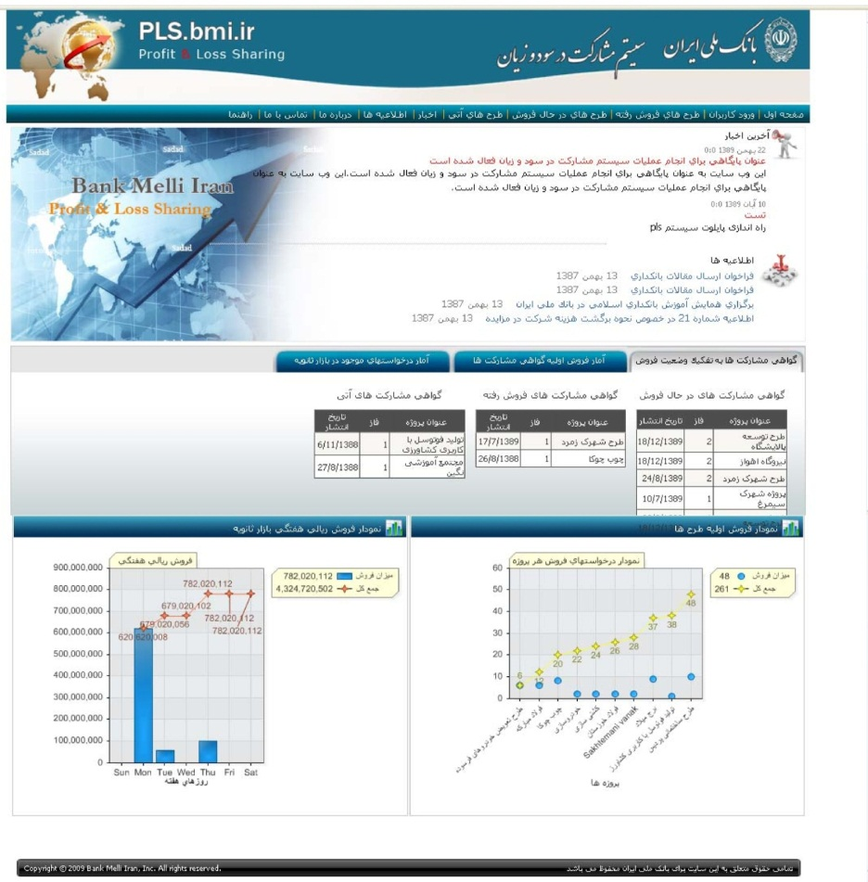
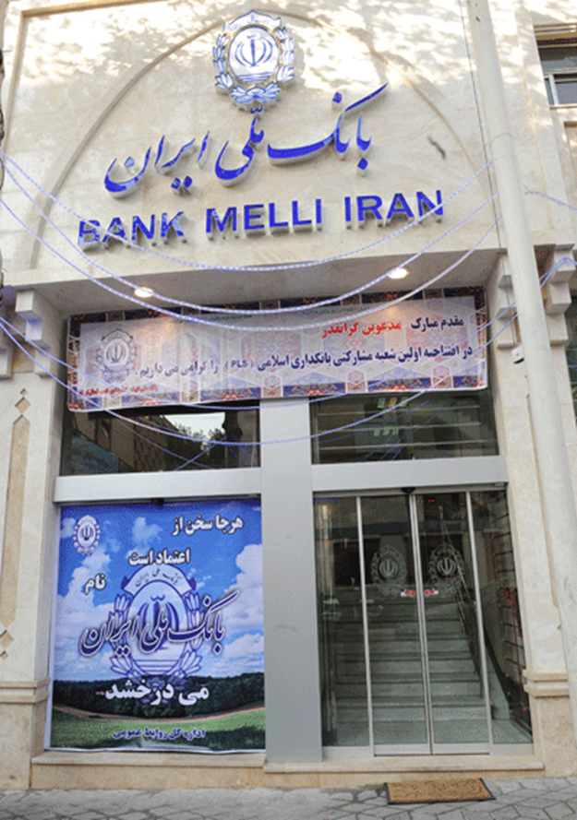
سامانه بازار گواهی راستین http://pls.bmi.ir/
شعبه مشاركتي قبا

Slide 29
منابع
بانکداری راستین، جلد اول: مباحث نظری. بانکداری راستین، جلد دوم: مباحث کاربردی. بانکداری راستین، جلد سوم: مباحث اجرایی.
تألیف: بیژن بیدآباد
ناشر: مؤسسه نوین پژوهان، 1395.
موسسه نوین پژوهان دانش راستین
تلفن‌های 44038843 - 44042719

Slide 30
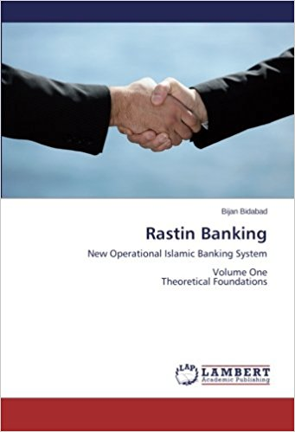
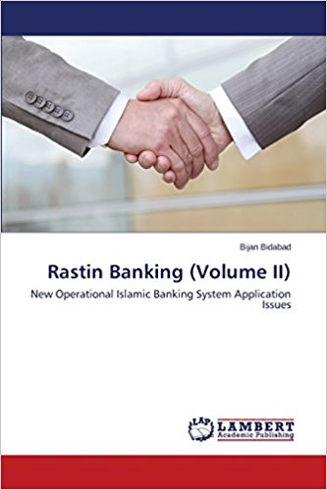
Resources
Rastin Banking (Volume I): New Operational Islamic Banking System Theoretical Foundations
Rastin Banking (Volume II): New Operational Islamic Banking System Application Issues
by Bijan Bidabad
https://www.amazon.com

Slide 31
Rastin Banking
Rastin Banking
Thanks
Bijan Bidabad
http://www.bidabad.com
bijan@bidabad.com

